Slide 1
Q.11.1.A
Express these statements using mathematical, logic and Boolean operators ?
a) An increasing population is when the number of new emigrants and the number of deaths is less than the number of new immigrants and the number of births.
b) Draw two counters of the same colour from a bag of blue and green counters on the first turn and then draw two counters of different colours on the second turn to win the game.

Slide 2
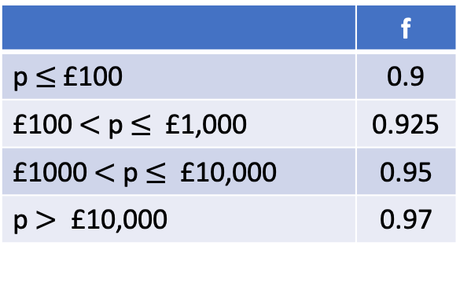
Q11.2.A
A UK currency conversion company calculates the amount received by the customer as:
r = p * m * f
r = amount received by customer
p = amount paid by customer (GBP £)
m = market conversion rate
f = scale factor (depends on r)
m depends on the currency being bought.
For US dollars $, m = 1.36
f depends on the amount paid, p:
Write a program using conditional statements to calculate r, for an input value, p.
 | f
p $≤$£100 | 0.9
£100$<$ p $≤$ £1,000 | 0.925
£1000$<$ p $≤$ £10,000 | 0.95
p $>$ £10,000 | 0.97

Slide 3
Q.11.2.B
Write a program that prints all the integers from 0 to 6 inclusive, using a loop.
Q.11.2.C
Write a program that prints every second element of a list, using a loop.
Q11.2.D
Write a program that requests a number from the user until the number input by the user is greater than 10.

Slide 4
Q.11.2.E
Write a program that prints all the integers from 0 to 6 inclusive, except 3 and 4, using a loop.
(Modify your answer to Q.11.2.B)
Q.11.2.F
Write a program that prints every element of a list of numbers, using a loop, exiting the loop before printing the number if a number greater than 10 is reached.

Slide 5
Q.11.3.A
Write a function, is_even.
Input:
n (integer)
Output:
True if n is even
False if n is not even
Q.11.3.B
Write a function to calculate gravitational potential energy of an object:
Input:
m (mass)
g (acceleration due to gravity)
h (height)
Output:
gravitational potential energy, E = mgh
m
g
h

Slide 6
Q.11.3.C
a) Write a function to calculate gravitational potential energy of an object, assuming g=9.81ms⁻² .
(Rewrite your answer to Q11.1.B)
b) Write a function to calculate gravitational potential energy of an object of mass 1kg, assuming g=9.81ms⁻².
m
g
h
Q.11.3.D
Write a function to find the magnitude of an n-dimensional vector:
$$\left\|a\right\|=\sqrt{a_{1}^{2}+a_{2}^{2}+ …+a_{n}^{2}}$$

Slide 7
Q.11.4.A
Create the numpy array:
[[6, 8, 10],
[12, 14, 16],
[18, 20, 22]]
Q.11.4.B
Find sin(x) for each value, x, in the list: $\left[\frac{π}{2}\text{, }π\text{, }\frac{π}{4}\right]$
Q.11.4.C
Add [6, 4, 2] to each row of the array in your answer to Q.11.4.A to get:
[[12, 12, 12],
[18, 18, 18],
[24, 24, 24]]
Q.11.4.D
Find the dot product of the four elements in the upper left corners of the 3x3 arrays in Q.11.4.A and Q.11.4.C

Slide 8
Q.11.4.E
Create a line plot of row 1 against row 0 of the numpy array:
[[6, 8, 10],
[18, 23, 12]]
Q.11.4.F
Create a scatter plot of the exponential function, $e^{x}$, for $x$ in the range 0 to 10 inclusive.

Slide 9
Q.11.5.A
Write a Python class which has two methods:
get_String : request string from user and assign value to class attribute
print_String : print the string in upper case
Q.11.5.B
Write a Python class, Square_analyser which:
is constructed using a single input argument, h (length of one side).
has two methods:
area : prints the area of the square
perimeter : print the perimeter of the square

Slide 10
Q.11.5.C
Write a child class, Rectangle_analyser, inherited from Square_analyser (Q.11.5.B), that:
is constructed using two input variables:
h - height
w - width
has two methods:
area : prints the area of the rectangle
perimeter : prints the perimeter of the rectangle

